Slide 1

Breast Cancer Wisconsin (Diagnostic) Data Set

Slide 2
WHY? we chose Breast Cancer Wisconsin dataset because its important to raise awareness about this cancer. This kind of cancer is one of the most common cancer and as early detection can catch the disease when it is most treatable. In addition, the dataset is biology data, and it fits to machine learning as we wanted

Slide 3
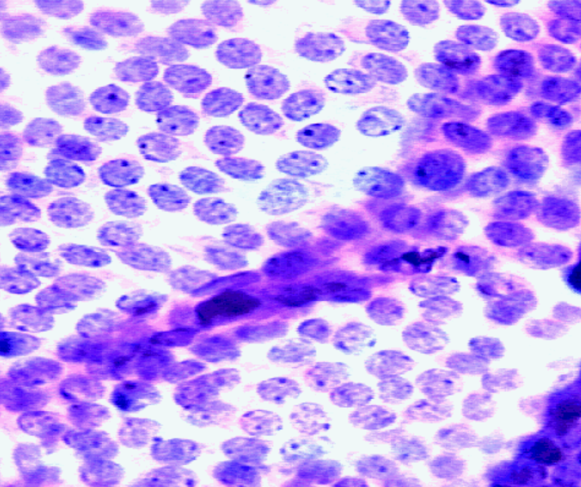
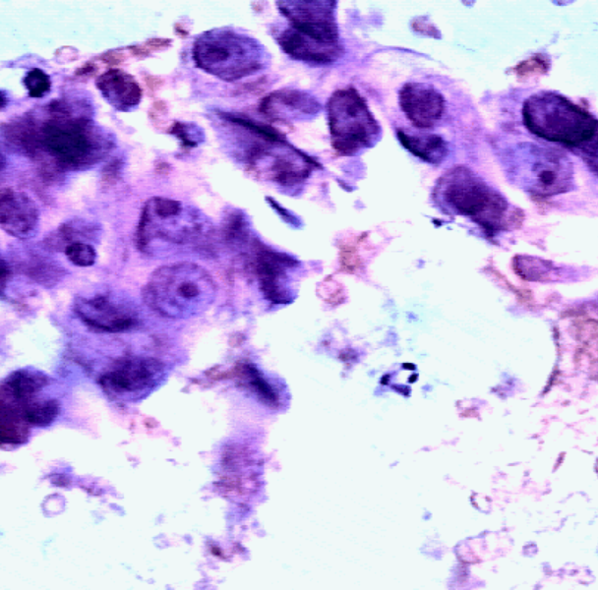
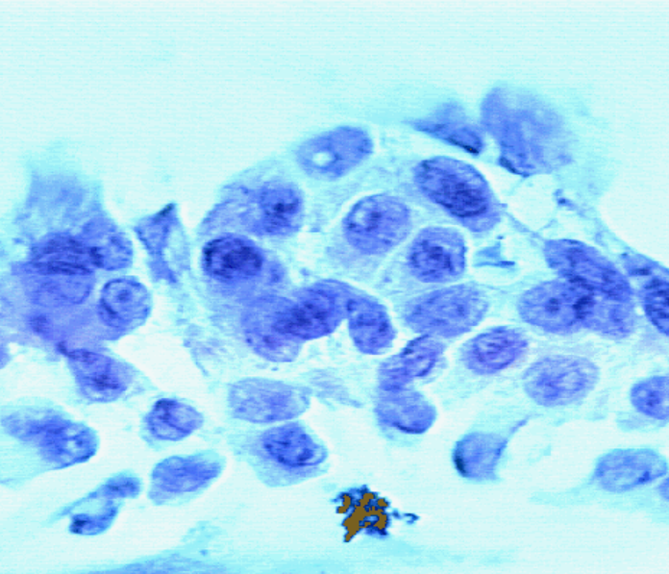
Breast Cancer Wisconsin data set includes 569 instances – Benign, Malignant.
Features are computed from a digitized image of a breast mass.
They describe characteristics of the cell nuclei present in the image.
Notes:
Benign = שפיר
Malignant = ממאיר

Slide 4
Ten real-valued features are computed for each cell nucleus:
Shape measurements:
radius
perimeter
area
concavity
concave points
Symmetry
fractal dimension
Texture measurements:
texture
smoothness
compactness
Notes:
Perimeter = היקף, concavity = קיעור של קווי המתאר, Texture – נמדד לפי הצבע, smoothness – נמדד לפי השינוי המקומי בצבע,
compactness = צפיפות.

Slide 5
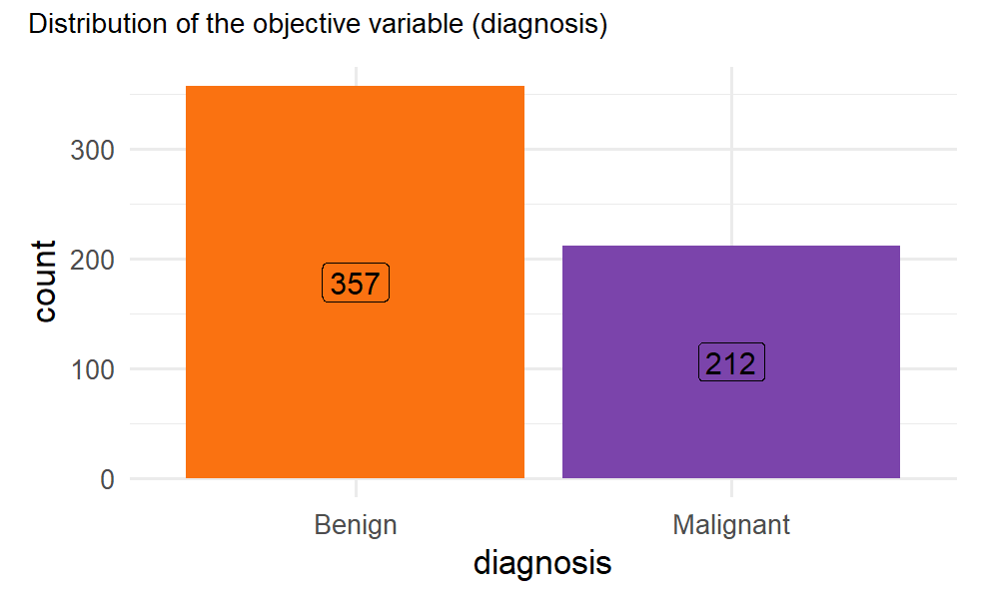
In total, there are 30 features in the dataset
Notes:
המטרה היא לעשות את הקליסטור על פי הפיצרים לממאיר ושפיר

Slide 6
We divided the features into 3 different groups:
Mean values, Standard error values and Worst values.
And checked if the distribution is similar in all groups.

Slide 7
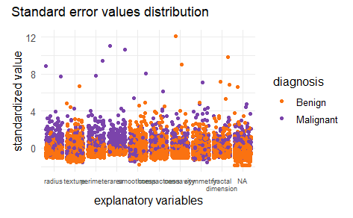
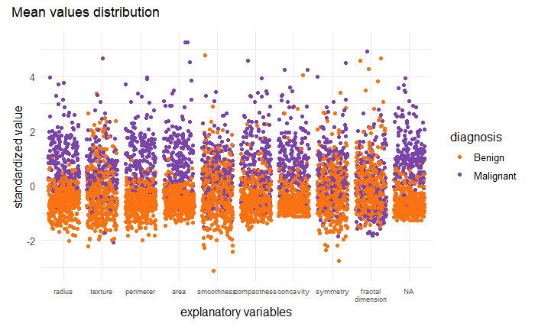
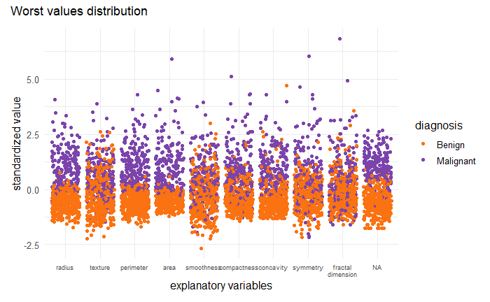
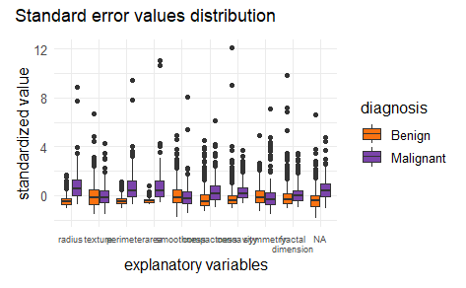
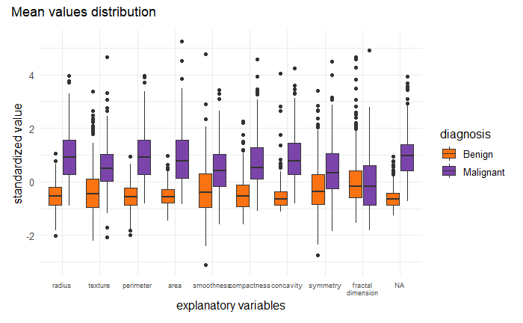
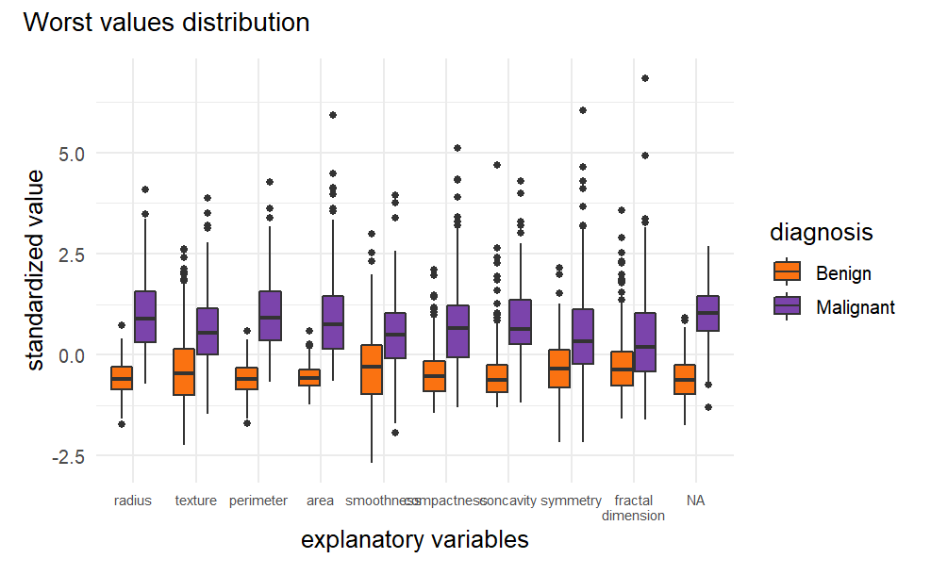
WORST
STANDARD ERROR
MEAN
Notes:
We can see for all the groups that not all features has the same distribution of malignant and benign samples.

Slide 8
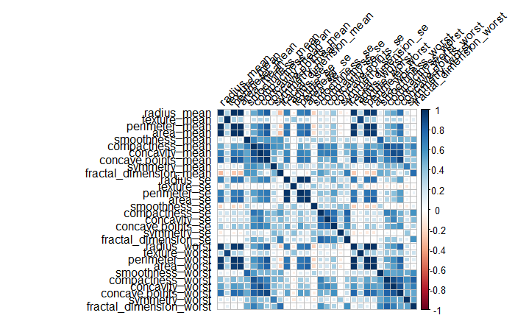
Notes:
before

Slide 9
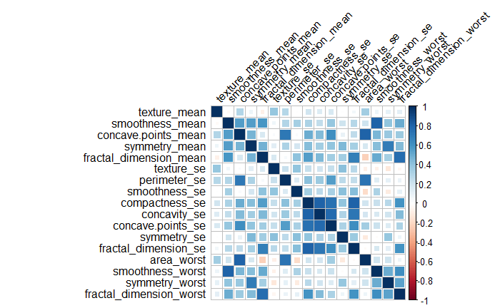
Notes:
after

Slide 10
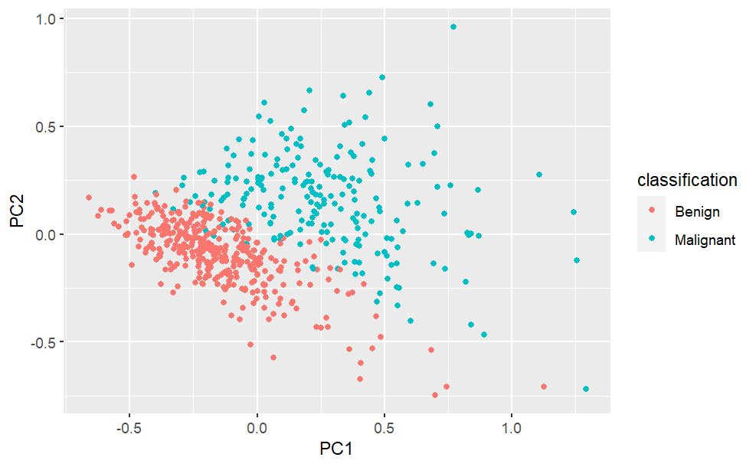
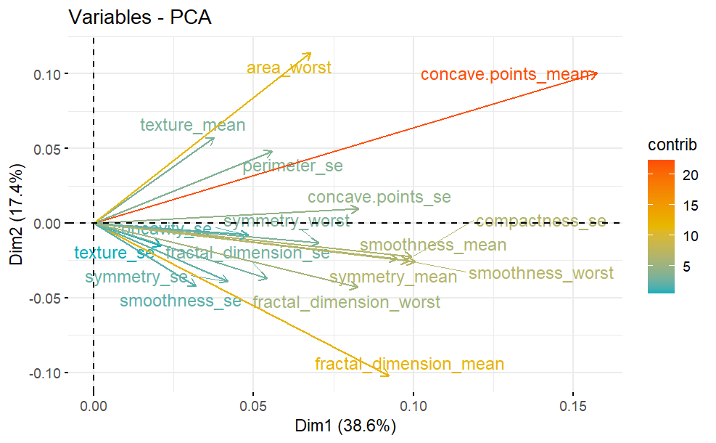
Min-Max Normalization
Notes:
Min max

Slide 11
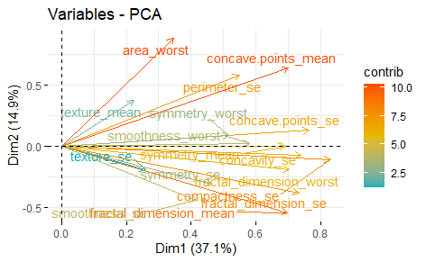
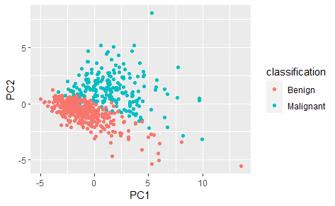
Z-Score Normalization

